Slide 1
Mobile and Wireless Technology CT090-3-2-MWT Version VD01
Radio Frequency (RF) Fundamentals for WLAN

Slide 2
Topic & Structure of The Lesson
Radio Frequency (RF) Fundamentals for Wireless LAN Technology
Frequencies Used for Wireless LANs
Coverage and Capacity
Basic Units of RF Measurement
RF Range and Speed
Environment: RF Behavior

Slide 3
Learning Outcomes
At the end of this topic, You should be able to:
Know the basic characteristics or properties of radio frequency.
Be familiar with the frequencies used for wireless networks.
Understand wireless network coverage and capacity.
Know what RF factors will affect the range and speed of wireless networks.
Identify basic RF units of measurement.

Slide 4
Key Terms You Must Be Able To Use
If you have mastered this topic, you should be able to use the following terms correctly in your assignments and exams:
Radio Frequency (RF)
Coverage
Capacity
Line of sight
Interference
Reflection
Refraction
Diffraction
Scattering
Absorption

Slide 5
Topic & Structure of The Lesson
Radio Frequency (RF) Fundamentals for Wireless LAN Technology
Frequencies Used for Wireless LANs
Coverage and Capacity
Basic Units of RF Measurement
RF Range and Speed

Slide 6
Radio Frequency Fundamentals for Wireless LAN
Radio frequency (RF) plays an essential role in wireless LAN technology.
What is Radio Frequency?
RF is a Radio Frequency, a electromagnetic wave.
Radio waves/Radio Frequency waves/Electromagnetic waves are passed through the air (which is the medium) and are used to get information from one wireless device to another.

Slide 7
Radio Frequency Fundamentals for Wireless LAN
How these Radio waves/Radio Frequency waves/Electromagnetic waves are generated?
High frequency alternating current (AC) signals passing over a copper cable connected to an antenna.
The antenna then transforms the signal into radio waves that propagate through the air from a transmitter to a receiver.

Slide 8
Radio frequency (RF) waves are used in a wide range of communications, including:
Radio
Television
Cordless phones
Wireless LANs, and
Satellite communication.
RF is around everyone and everything, and comes in many forms. Radio waves range from 3Khz to 300 Ghz.
Radio Frequency Fundamentals for Wireless LAN

Slide 9
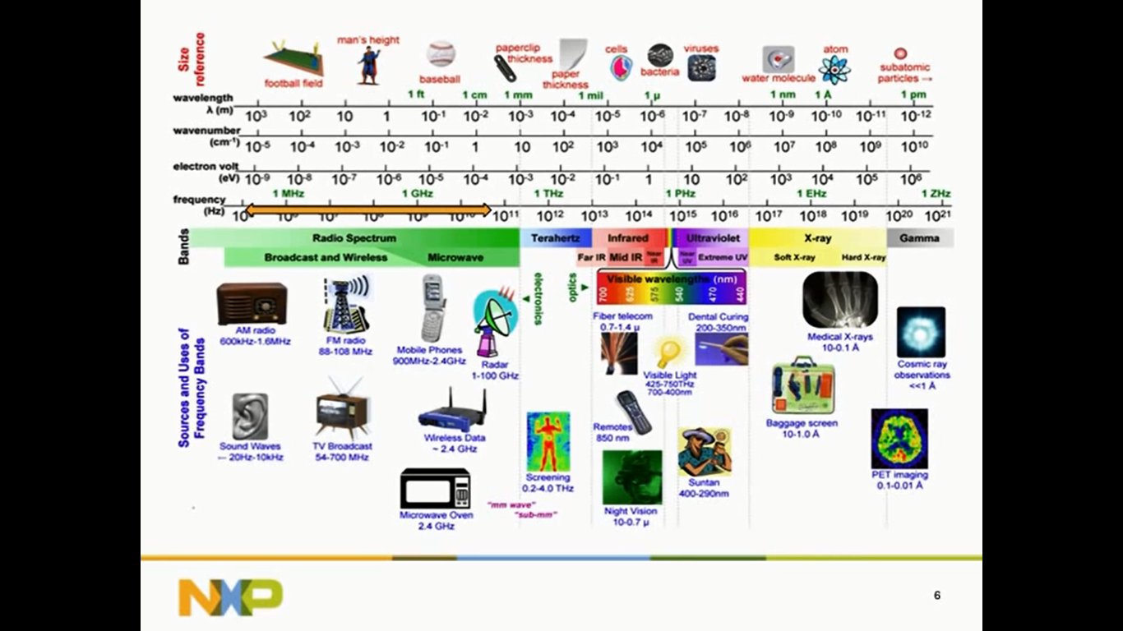

Slide 10
Radio Frequency Fundamentals for Wireless LAN
RF spectrum is governed by local regulatory bodies.
Location Regulation
Malaysia Malaysian Communications and Multimedia Commission(MCMC)
Canada ISC RSS-210
China RRL/MIC Notice 2003-13
Europe (ETSI) ETS 300.328
ETS 301.893
Israel MOC
Japan (MKK) TELEC 33B
TELEC ARIB STD-T71
Singapore IDA/TS SSS Issue 1
Taiwan PDT
USA FCC (47 CFR) Part 15C, Section 15.247
FCC FCC (47 CFR) Part 15C, Section 15.407

Slide 11
Topic & Structure of The Lesson
Radio Frequency (RF) Fundamentals for Wireless LAN Technology
Frequencies Used for Wireless LANs
Coverage and Capacity
Basic Units of RF Measurement
RF Range and Speed

Slide 12
Frequencies used for Wireless LAN
The Wireless LAN (IEEE 802.11) standard addresses the 2.4 GHz ISM band and the 5 GHz UNII bands.
The 2.4 GHz ISM band allows for 11 of 14 channels to be used for wireless LAN communications.
The 5 GHz UNII band consists of three bands utilizing four frequency ranges.
The three bands are:
UNII-1, the lower band;
UNII-2 and
UNII-2e

Slide 13
Topic & Structure of The Lesson
Radio Frequency (RF) Fundamentals for Wireless LAN Technology
Frequencies Used for Wireless LANs
Coverage and Capacity
Basic Units of RF Measurement
RF Range and Speed

Slide 14
Coverage and Capacity
Coverage and capacity are two key factors to take into consideration when designing and implementing an IEEE 802.11 wireless LAN.
During the design phase of an IEEE 802.3 Ethernet wired network, the design engineer will take capacity into consideration, verifying and validating that there are enough capacity switches, ports, etc., for the user base of the network.

Slide 15
Coverage and Capacity
The term coverage has different meanings depending on the context in which it used.
For example, if you buy a gallon of paint, the label will specify the approximate coverage area in square feet.
If one gallon of paint covers 300 square feet and the room you wish to paint is 900 square feet, simple math shows at least three gallons of paint would be needed to effectively
cover the room.

Slide 16
Coverage and Capacity
The concept is similar in IEEE 802.11 wireless networks.
However, unlike with paint, there is no simple rule that determines how much space an access point will cover with the RF energy it is transmitting.
This coverage will depend on many factors, some of which include:
Size of area
Number of users
Applications in use
Obstacles, propagation and Radio Frequency Range
WLAN Hardware and Output Power

Slide 17
Coverage and Capacity
1. Size of area –
The amount of area an access point will cover.
Manufacturer (ASUS/TPLINK) of wireless LAN hardware will not commit to the amount of area an access point will cover.
A site survey of the area will help determine the coverage area of an access point.
2. Number of users –
The number of users in an area will also affect the RF coverage.
Too many users using powerful applications
will overload the access point, adding to the poor performance issues.

Slide 18
Coverage and Capacity
3. Applications in Use –
The application types in use - either software or hardware - can affect the bandwidth of an access point.
If the users connected to an access point use bandwidth-intensive applications such as the Computer Aided Design and Manufacturing (CAD/CAM) application, this could result in poor throughput for all users connected to that access point.

Slide 19
Coverage and Capacity
4. Obstacles, Propagation and Radio Frequency Range
Obstacles in an area, such as walls, doors, windows, and furnishings, as well as the physical properties of these obstacles - thickness of the walls and doors, density of the windows, and type of furnishings - can also affect coverage.
The radio frequency used - either 2.4 GHz or 5 GHz - will determine how well a signal will propagate and handle an obstacle.

Slide 20
5. WLAN Hardware and Output Power
The wireless LAN hardware in use can also have an impact on the coverage area.
Examples include the antenna type, antenna orientation, and gain of the antenna.
The higher the gain of an antenna, the greater the coverage area; conversely, the lower the gain of an antenna, the smaller the coverage area.
The polarization of an antenna (horizontal vs. vertical) will also have an effect on the coverage area because of the different shapes of the radiation patterns.
Coverage and Capacity

Slide 21
Coverage and Capacity
5. WLAN Hardware and Output Power
The output power of the transmitter or access point will also have an effect on coverage. The higher the output power, the greater distance a signal will propagate.
A higher power signal will provide more coverage.

Slide 22
Coverage and Capacity
Just as an elevator or a restaurant has a limited number of people they can accommodate comfortably, wireless access points also have a capacity.
The capacity of an access point is how many users the AP can service effectively, offering the best performance.
This capacity depends on several factors, including:
Software applications in use
Number of users

Slide 23
Topic & Structure of The Lesson
Radio Frequency (RF) Fundamentals for Wireless LAN Technology
Frequencies Used for Wireless LANs
Coverage and Capacity
Basic Units of RF Measurement
RF Range and Speed

Slide 24
Basic Units of RF Measurement
A wireless access point may be set to an output of 30 mW (milliwatts) of power.
A milliwatt is 1/1000 of a watt.
Watts and milliwatts are measurements of RF power.
Other units of measurement for RF are dB, dBi, dBd, and dBm.

Slide 25
Topic & Structure of The Lesson
Radio Frequency (RF) Fundamentals for Wireless LAN Technology
Frequencies Used for Wireless LANs
Coverage and Capacity
Basic Units of RF Measurement
RF Range and Speed

Slide 26
RF Range and Speed
How far and fast an RF signal can travel depends on a variety of factors, including
line of sight,
interference,
Environment: RF Behavior
RF communication between devices in 802.11 wireless networking requires a line of sight.
There are two types of line of sight to take into consideration: visual and RF.

Slide 27
RF Range and Speed – Line of Sight
RF communication between devices in 802.11 wireless networking requires a line of sight.
There are two types of line of sight to take into consideration: visual and RF.

Slide 28
RF Range and Speed – Line of Sight
Visual line of sight is the ability of the transmitter and receiver to see each other.
In order for wireless networking direct link communication to be successful there should be a clear, unobstructed view between the transmitter and receiver.
An unobstructed line of sight means few or no obstacles blocking the RF signal between these devices.

Slide 29
RF Range and Speed – Line of Sight
The RF line of sight, or the radio transmissions between a transmitter and receiver, could be affected if the total area of radio frequency transmissions(the Fresnel zone )is blocked by more than 40 percent.
This blockage could be from a variety of sources such as trees, buildings, terrain, or other obstacles, including the curvature of the earth.

Slide 30
RF Range and Speed - Interference
Interference from a radio frequency point of view occurs when a receiver hears two different signals on the same or similar frequencies.
Interference causes distortion.
In wireless LANs, this interference can have a severe impact on the quality of signal received by the wireless device.

Slide 31
RF Range and Speed - Interference
IEEE 802.11 wireless network may use the unlicensed 2.4 GHz industrial, scientific, and medical (ISM) band. This band is also used for many other devices, including:
Cordless phones
Microwave ovens
Medical devices
Industrial devices
Baby monitors

Slide 32
RF Range and Speed –Interference
a) Co-channel and Adjacent Channel Interference
Co-channel or adjacent channel interference occurs when two devices in the same physical area are tuned to a close or same radio frequency channel.
For example, an access point on channel 1 and another access point on channel 2 in close or hearing range of each other will experience adjacent channel interference.

Slide 33
RF Range and Speed - Interference
b) WLAN/WPAN Interference
The performance of IEEE 802.11 wireless networks can be affected when they are co located with IEEE 802.15 wireless personal area networks or WPANs.
Bluetooth is an example of a personal area network. Like 802.11, Bluetooth devices operate in the 2.4 GHz frequency range and use frequency hopping spread spectrum (FHSS).

Slide 34
RF Range and Speed - Interference
c) Bright Sunlight Interference
Bright sunlight will not affect wireless LAN communications that use the 2.4 GHz ISM and 5 GHz UNII bands;

Slide 35
RF Range and Speed - Environment
Environment: RF Behavior
RF behavior is the result of environmental conditions including:
1. Reflection
2. Refraction
3. Diffraction
4. Scattering
5. Absorption
6. Diffusion

Slide 36
RF Range and Speed - Environment
1. Reflection –
Reflection occurs when an RF signal bounces off a smooth, non absorptive surface such as a table top and changes direction.
Reflections can affect indoor wireless LAN installations fairly significantly in certain cases. Depending on the interior of the building—such as the type of walls, floors, or furnishings—there could be a large number of reflected signals.
If not properly handled, reflections could cause a decrease in throughput and poor network performance.

Slide 37
RF Range and Speed - Environment
2. Refraction
When an RF signal passes between mediums of different densities, it may change speeds and also bend. This behavior of RF is called refraction. Glass is an example of material that may cause refraction.
When an RF signal comes in contact with an obstacle such as glass, the signal is refracted (bent) as it passes through and some of the signal is lost.

Slide 38
RF Range and Speed - Environment
3. Diffraction
When an RF signal passes an obstacle, the wave changes direction by bending around the obstacle. This RF behavior is called diffraction. A building or other tall structure could cause diffraction, as could a column in a large open area or conference hall.
When the signal bends around a column, building, or other obstacle, the signal weakens, resulting in some level of loss.

Slide 39
RF Range and Speed - Environment
4.Scattering
When an RF signal strikes an uneven surface, wave fronts of the signal will reflect off the uneven surface in several directions. This is known as scattering.
Scattering is another form of loss that may severely degrade the RF signal.

Slide 40
RF Range and Speed - Environment
5.Absorption
When material absorbs an RF signal, no signal penetrates through the material. An example of absorption is the human body.
The human body has a high water content and will absorb RF signals. This type of absorption can be a problem for wireless network deployments in certain environments.
Densely populated areas such as airports and conference halls need to consider absorption when designing a wireless LAN deployment.

Slide 41
Quick Review Question
Coverage and capacity will depend on many factors. What are they? Explain each of them.
How far and fast an RF signal can travel depends on a variety of factors. What are they? Explain each of them.

Slide 42
Summary of Main Teaching Points
This chapter looked at radio frequency basics and the essential role RF plays in the world of IEEE 802.11 wireless LANs. This chapter also looked at correct channel reuse to minimize interference from co-location of access points.
Coverage and capacity are two important areas that should be closely looked at in order to ensure a wireless deployment will offer reliable connectivity and perform well for the user base.
Finally, we discussed RF units of measure, including watt, milliwatt, dB, and dBi. We also looked at RF behaviors such as reflection, refraction, and absorption, and the impact of propagation on radio waves.

Slide 43
Question and Answer Session
Q & A

Slide 44
What we will cover next
WLAN Terminology and Technology

